Slide 1
ARS Convention Bremen
PRE CONVENTION TOUR
DENMARK & SOUTH SWEDEN

Slide 2
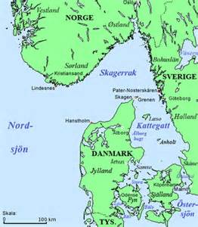
ARS Bremen Convention Pre Trip SCANDINAVIAN

Slide 3
ARS Bremen Convention 2018
PRE Convention Trip
Denmark Jylland
South Sweden
Denmark Zealand
Back to Bremen

Slide 4
Jørgen Jørgensen

Slide 5
Ribe City The Old Jailhouse Hotel

Slide 6
Ribe City Historik

Slide 7
Finn & Linda Bertelsen

Slide 8
Maren & Søren Tang

Slide 9
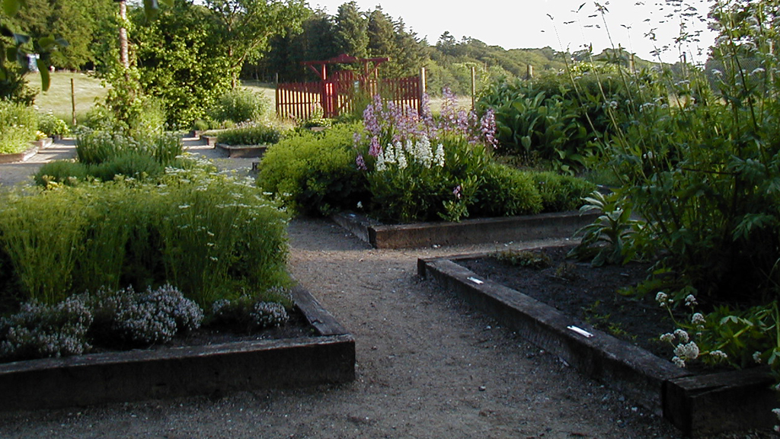
Bangsbo Botanic Garden

Slide 10
Restaurant MØLLEHUSET

Slide 11
Ferry from Frederikshavn to Gothenborg

Slide 12
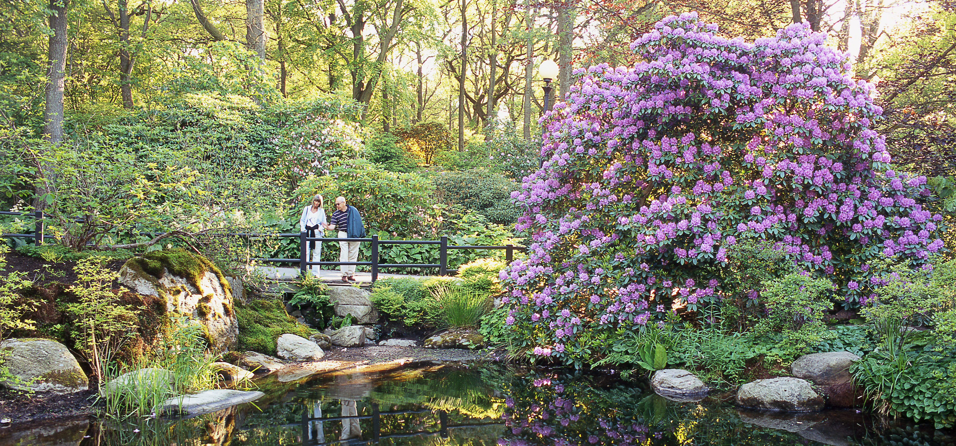
ARS 2018 N. America meets Europe
Göteborg botan Swedens best botanic garden. People Working at Göteborg botan have been to Himalaya several times in Rhododendron expeditions.

Slide 13
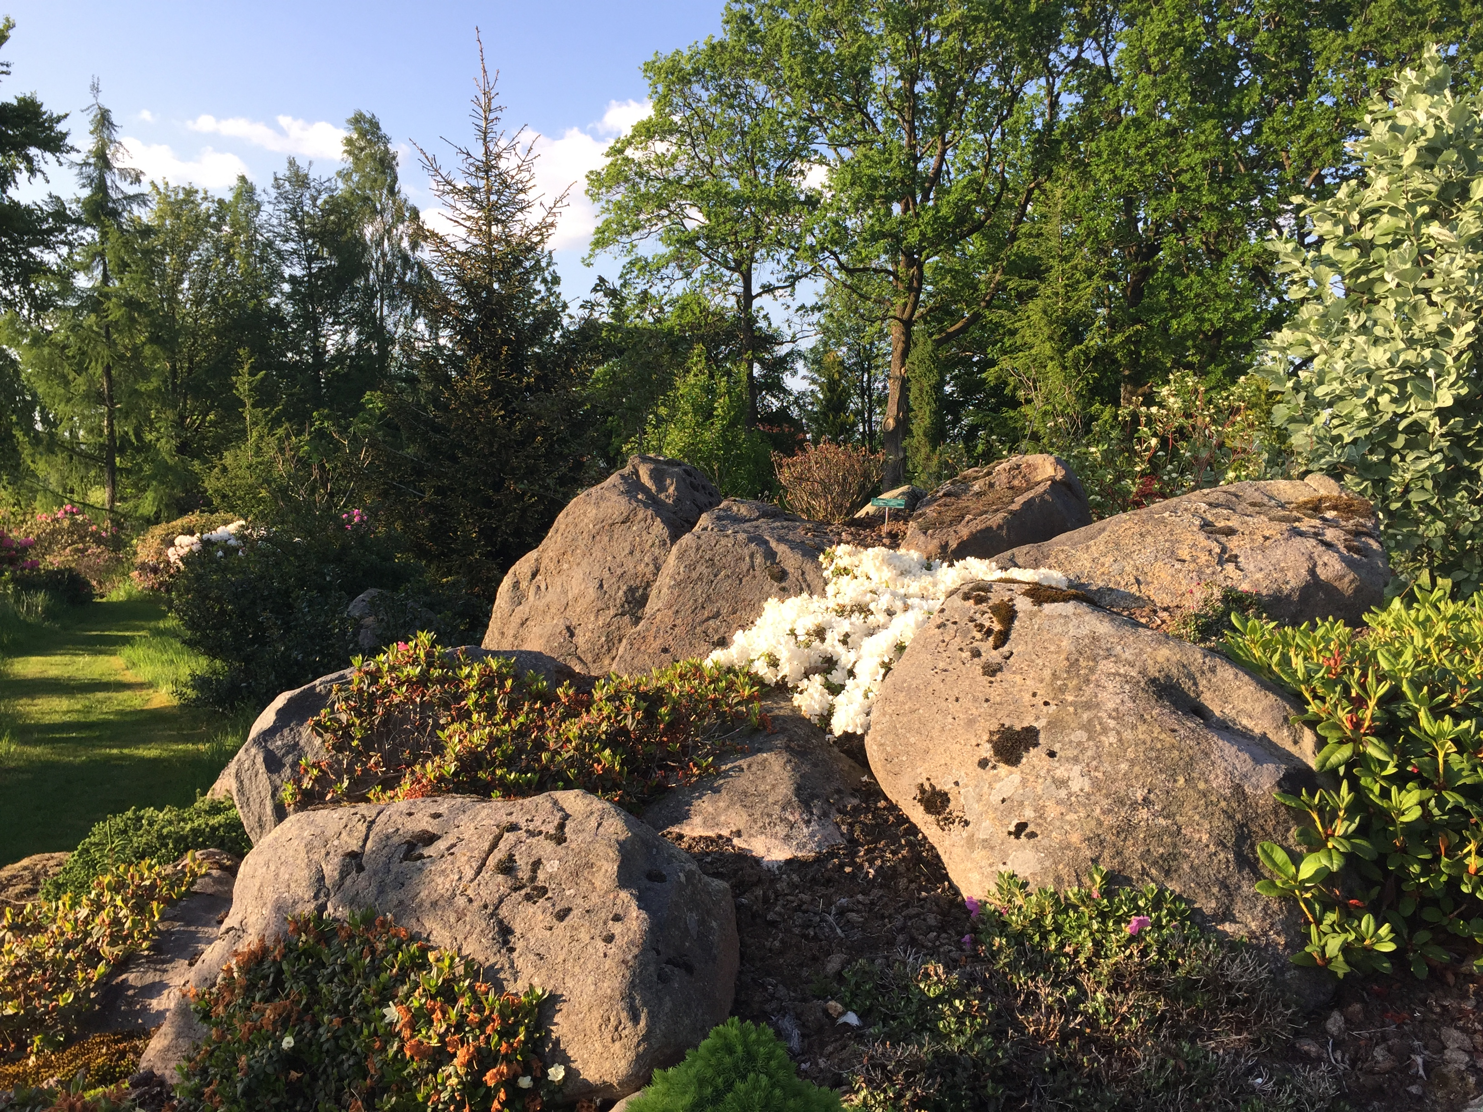
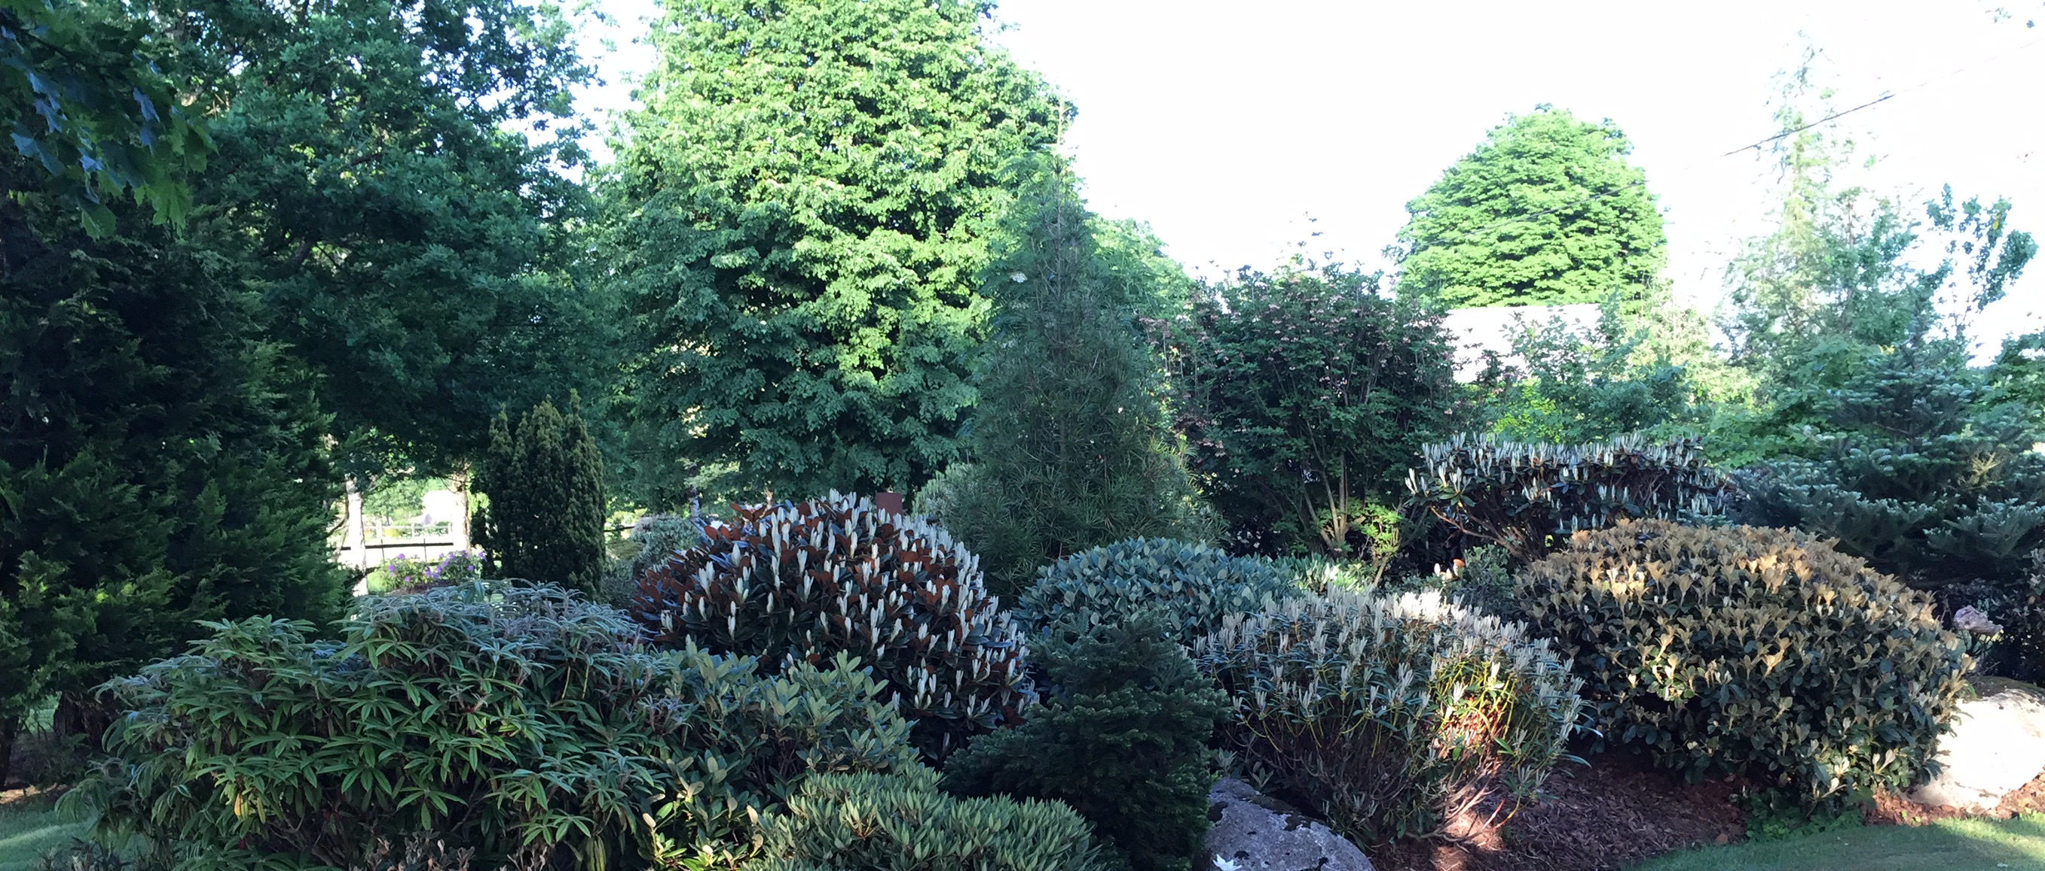
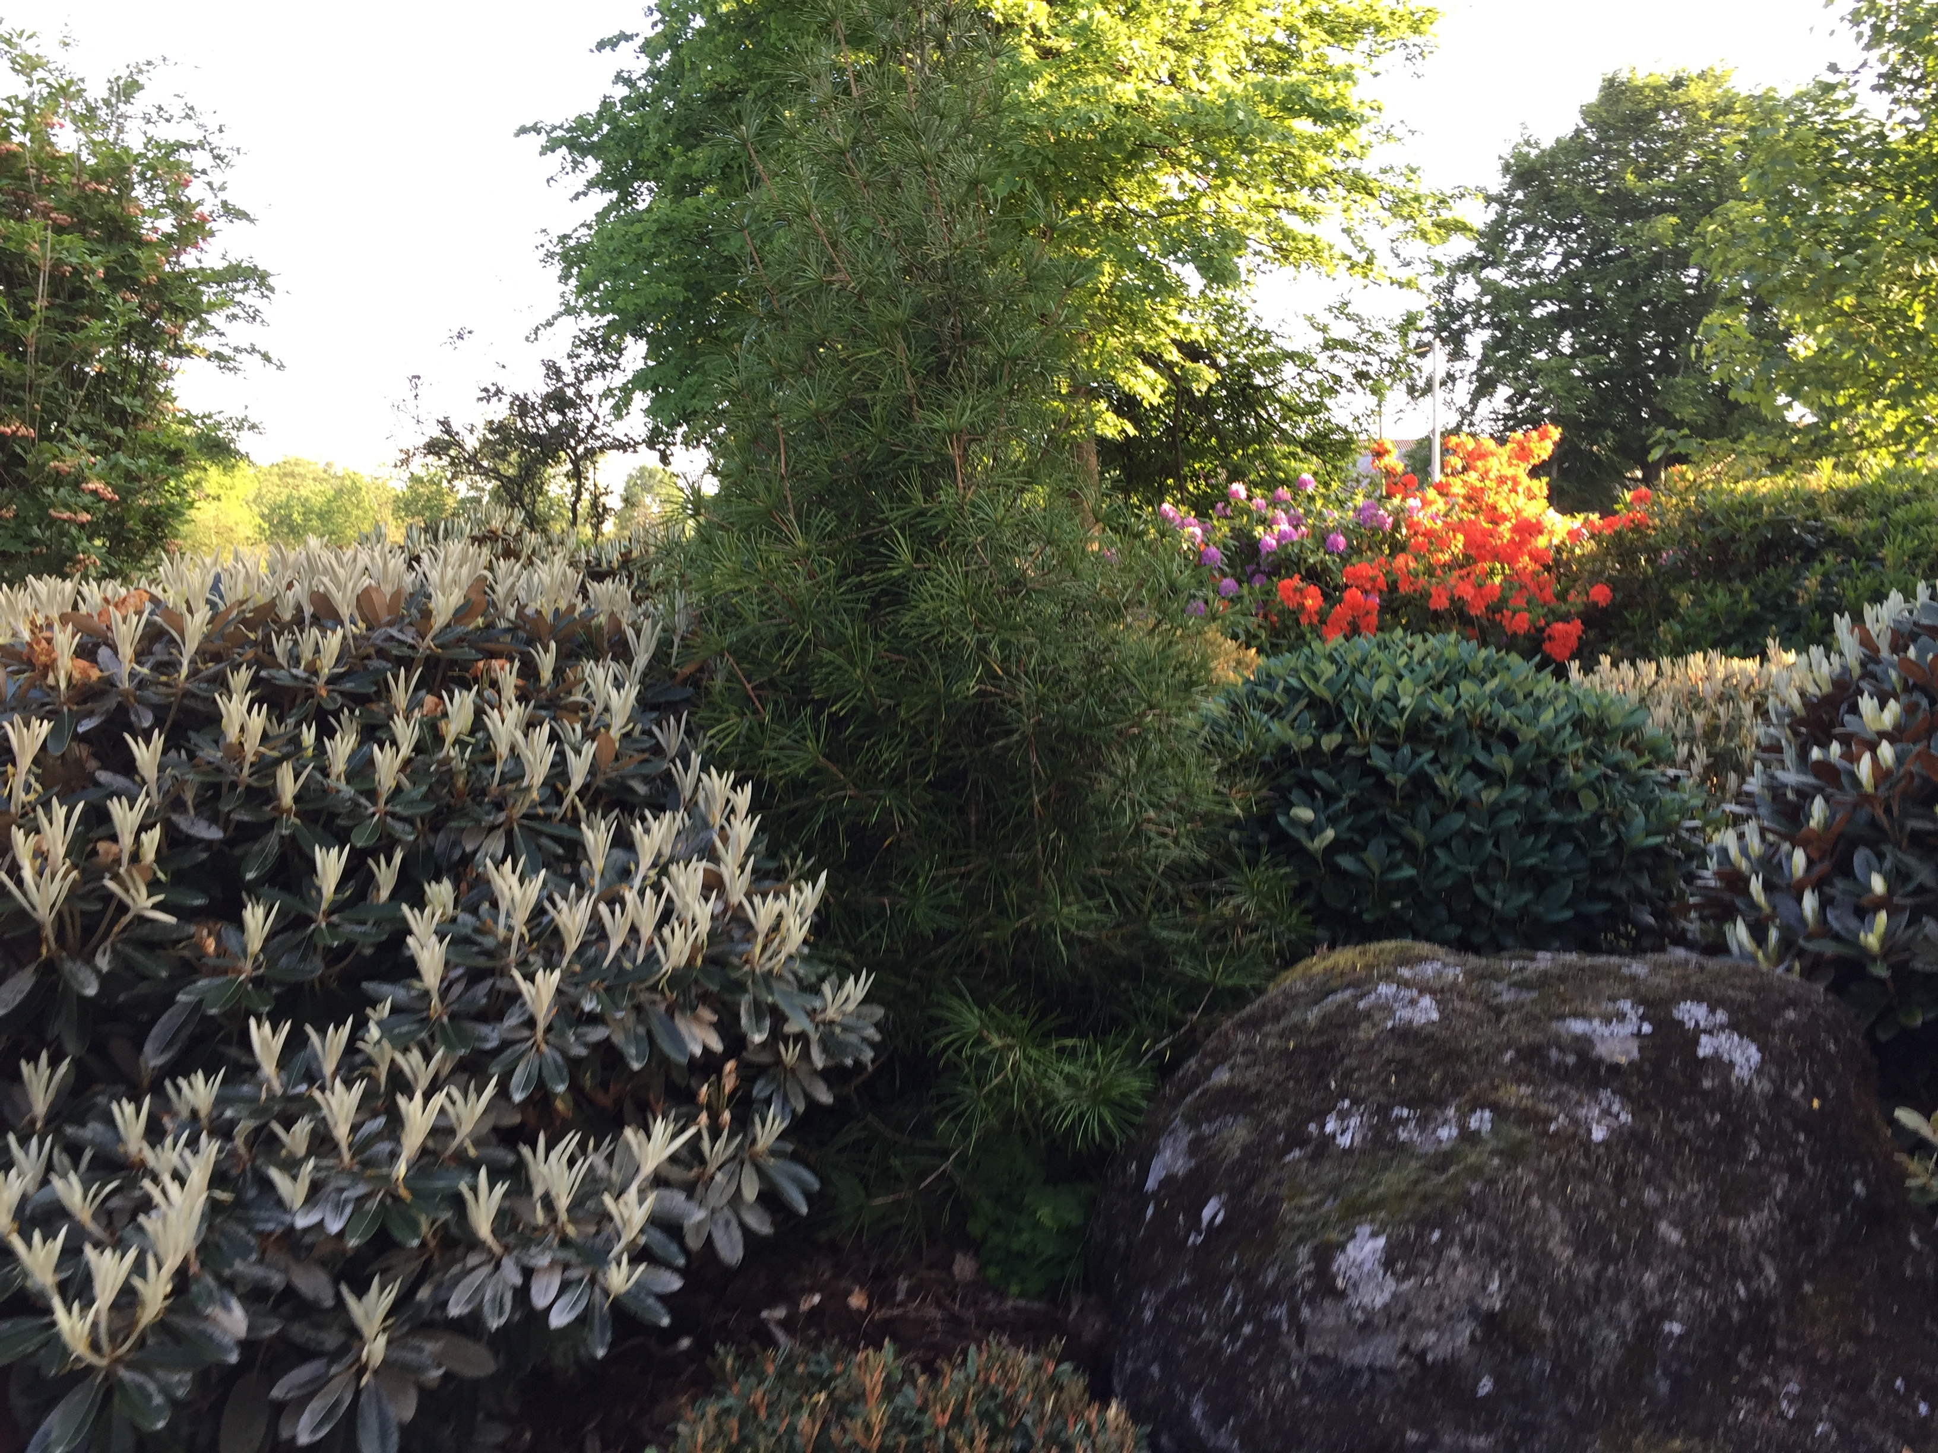
Ulf Jönsson 6000m2 garden (look at the plant shape they are living in a tuff Environment)

Slide 14
Torsten Nilsson Mölle6000m2 garden with magnificent vue
Please use the link to youtube to see the video of the garden.
"https://www.youtube.com/embed/CGLXTxD9

Slide 15
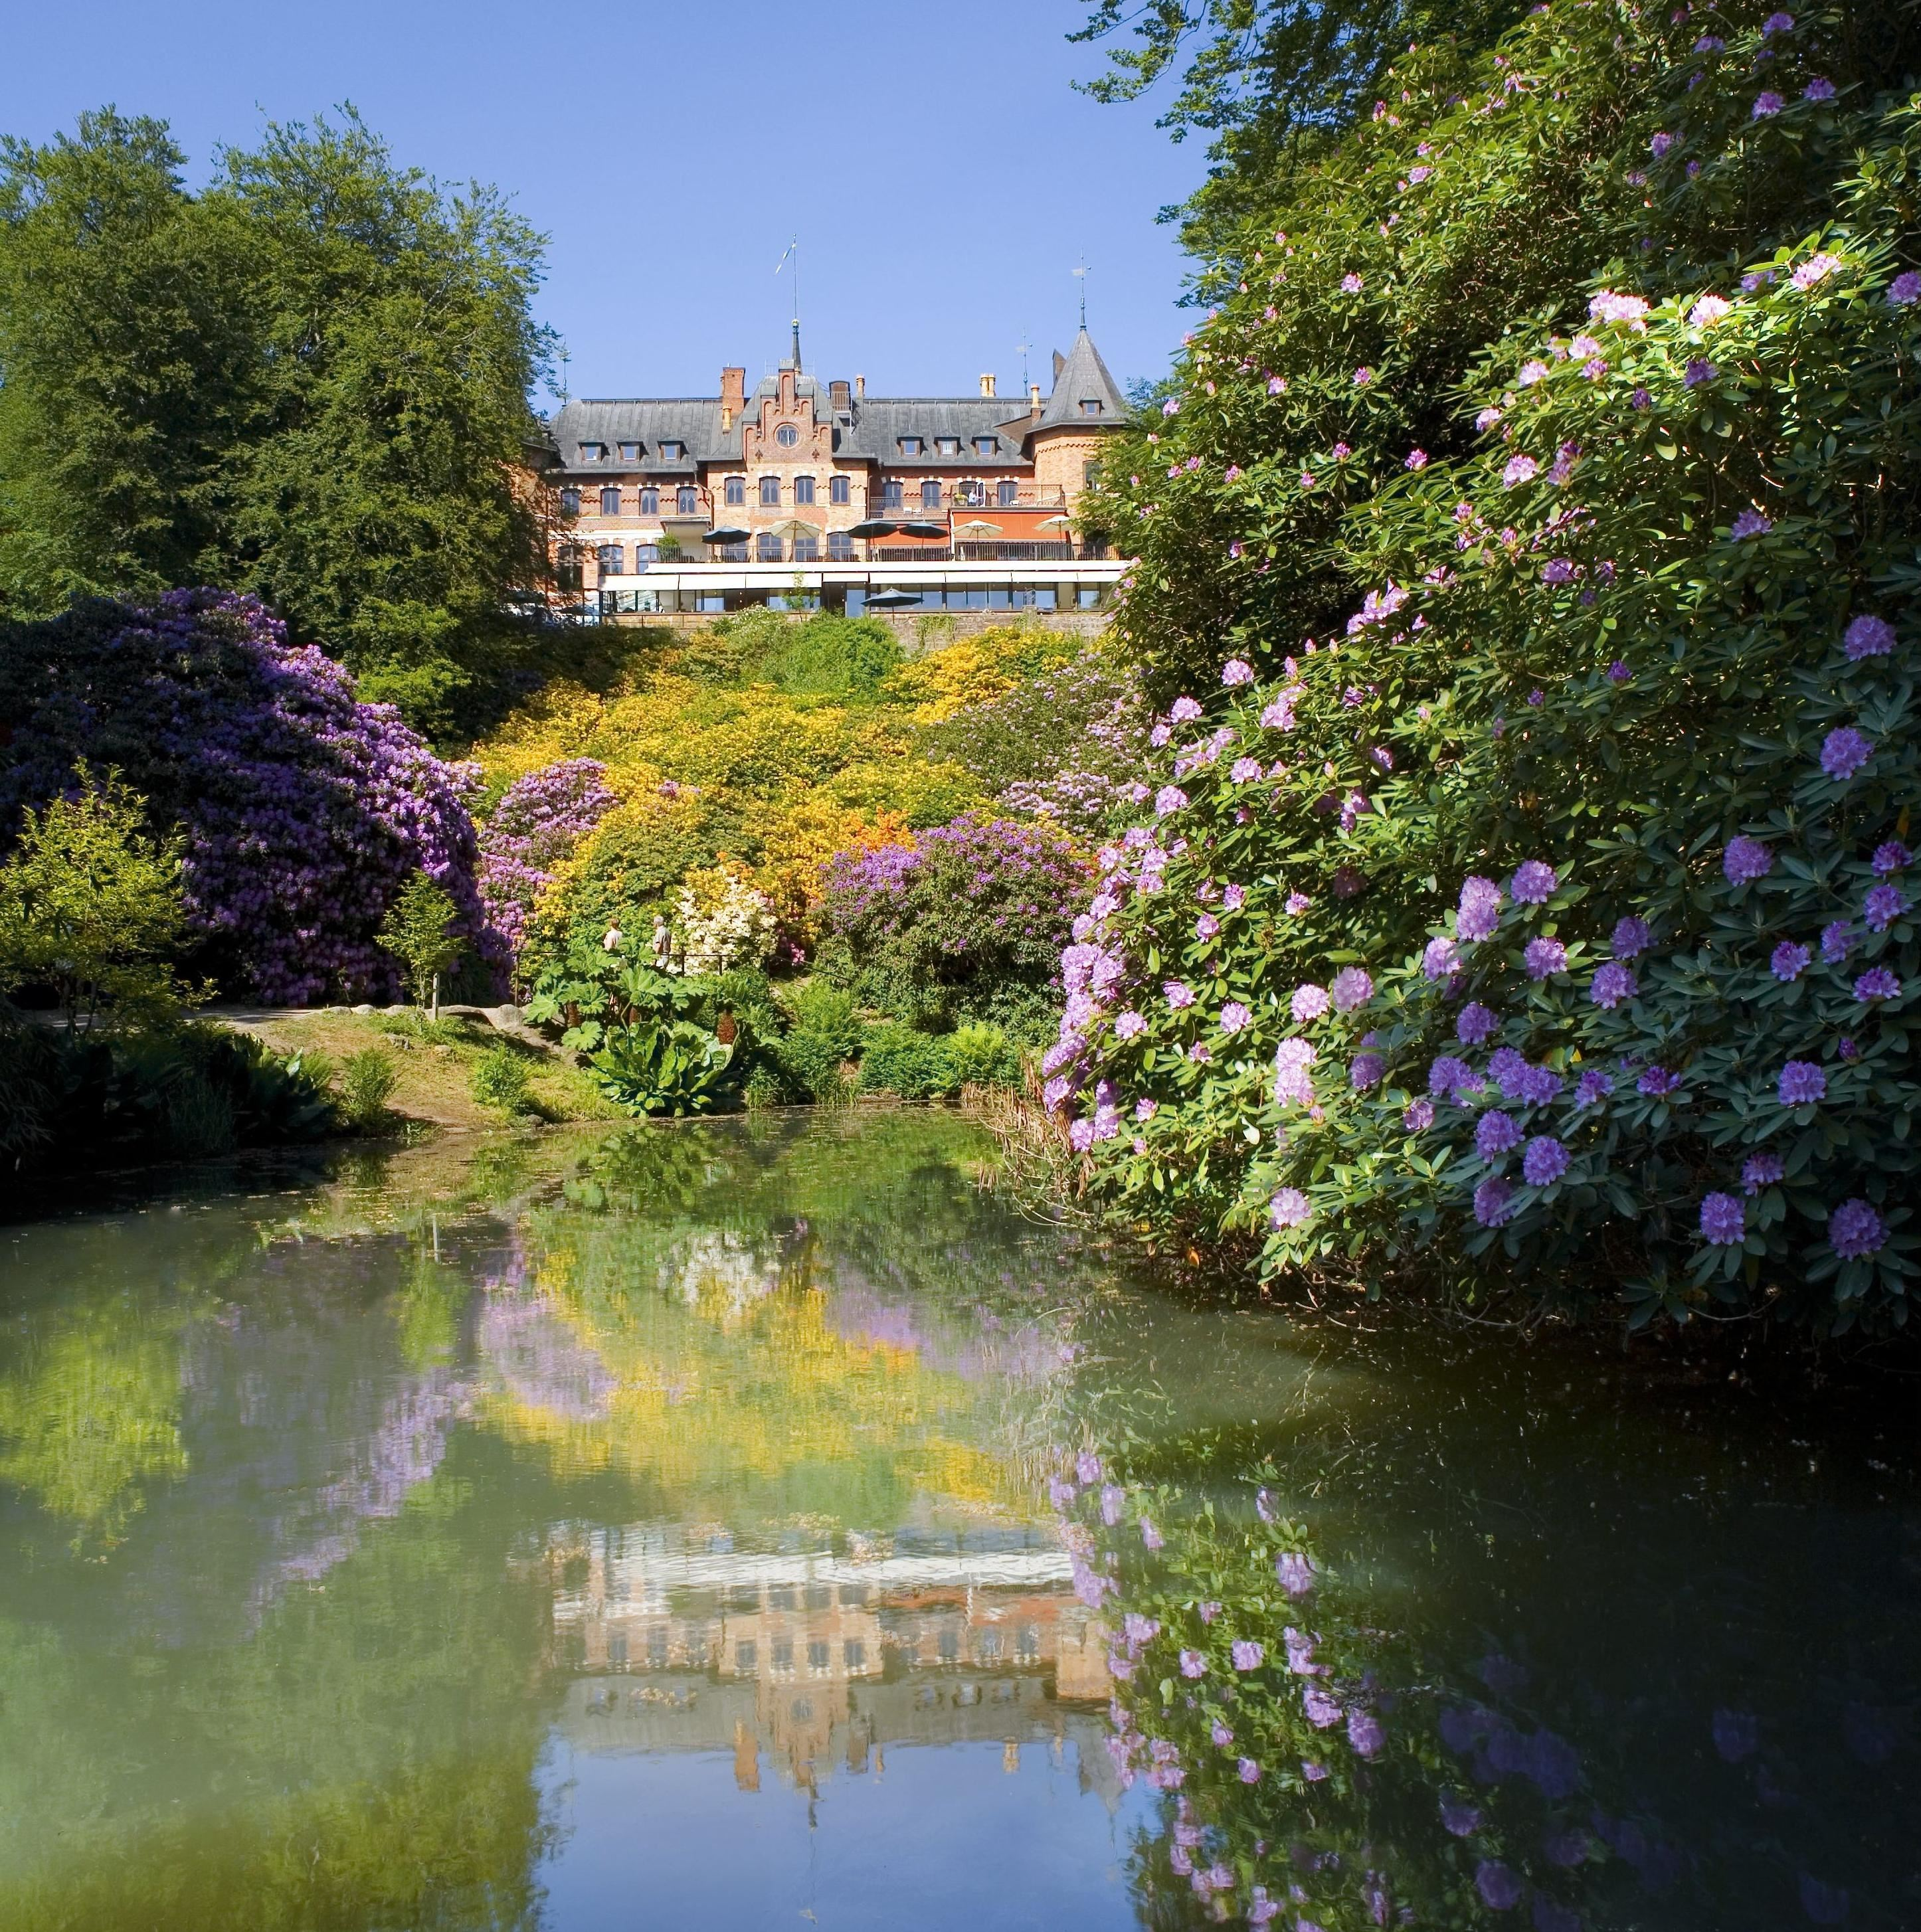
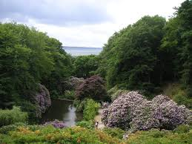
Sofiero Royal garden 150 years with rhododendron

Slide 16
From Helsingborg to Helsingør

Slide 17
Kronborg Hofmesterinde Beate Bille

Slide 18
NIVÅ Gård park

Slide 19
Hotel in Copenhagen
Hotel Tivoli
Hotel DGI
Hotel ?

Slide 20
Kjelds Have

Slide 21
Zen Garden

Slide 22
Henning Andersen

Slide 23
Mogens Bendix

Slide 24
Svend Hansen Kernehuset

Slide 25
Lulu Tophøj

Slide 26
Jørgen Halse

Slide 27
Asperup gård

Slide 28
BREMEN
Back to Bremen to relax.
Start of Convention.

