Slide 1
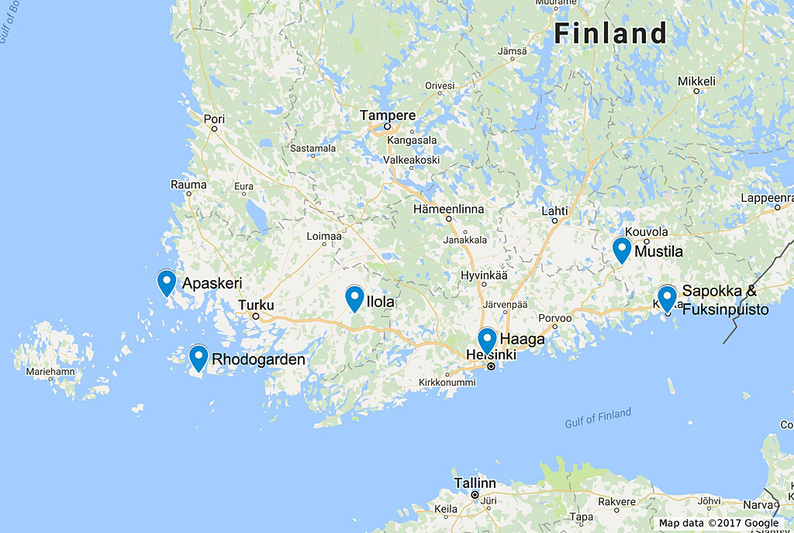
May 27 to 31, 2018
ARS 2018 Convention Post Tour in Finland

Slide 2
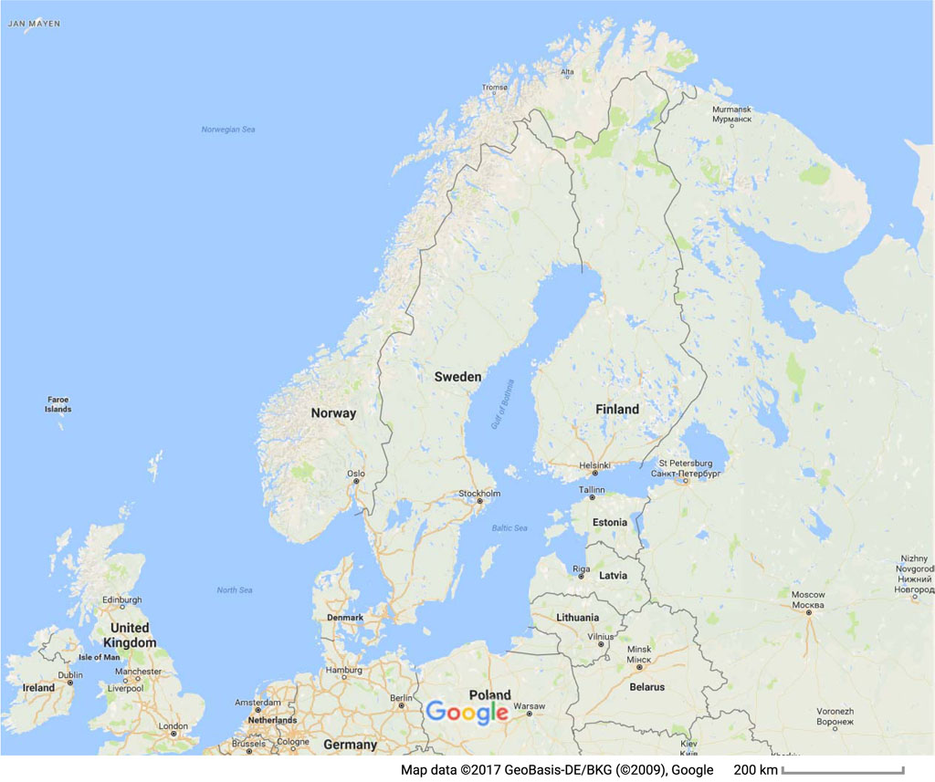
Schedule
Sunday, May 27
Flight from Hamburg to Helsinki
Monday, May 28
Haaga Rhododendron Park, Helsinki
Porvoo, a walk in the Old Town
Arboretum Mustila, Elimäki
Sapokka Water Garden and Fuksinpuisto Park, Kotka
Tuesday, May 29
Ilola Arboretum, Salo
Arboretum Apaskeri, Kustavi
Wednesday, May 30
Rhodogarden, Parainen
Thursday, May 31
Departure day or continue travel in Finland
Click on map to enlarge

Slide 3
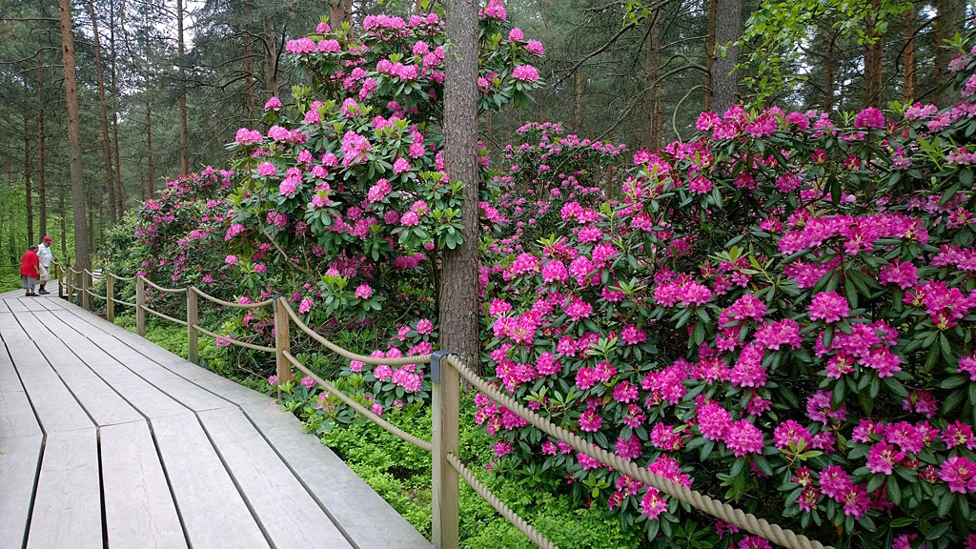
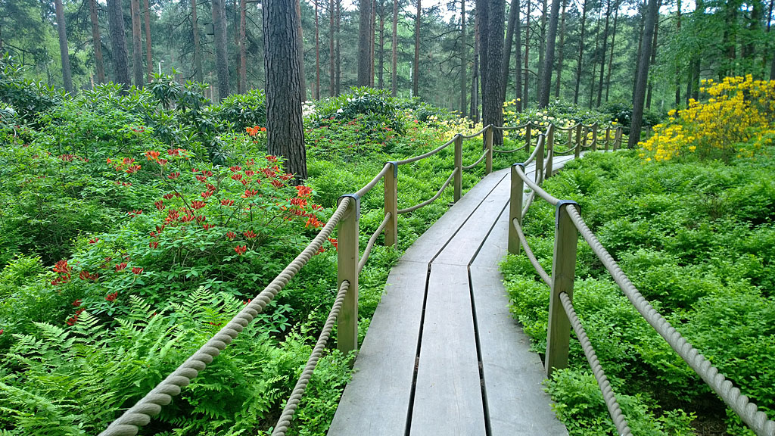
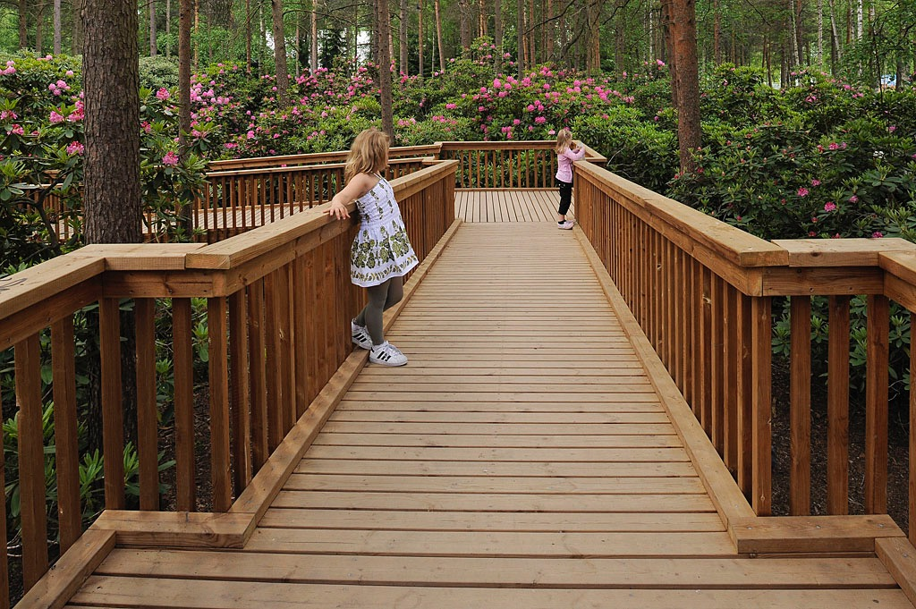
Haaga Rhododendron Park, Helsinki
The Haaga Rhododendron Park is a unique city park in which to admire huge rhododendrons and beautiful azaleas.
Photo credits: Satu Tegel and Vladimir Pohtokari

Slide 4
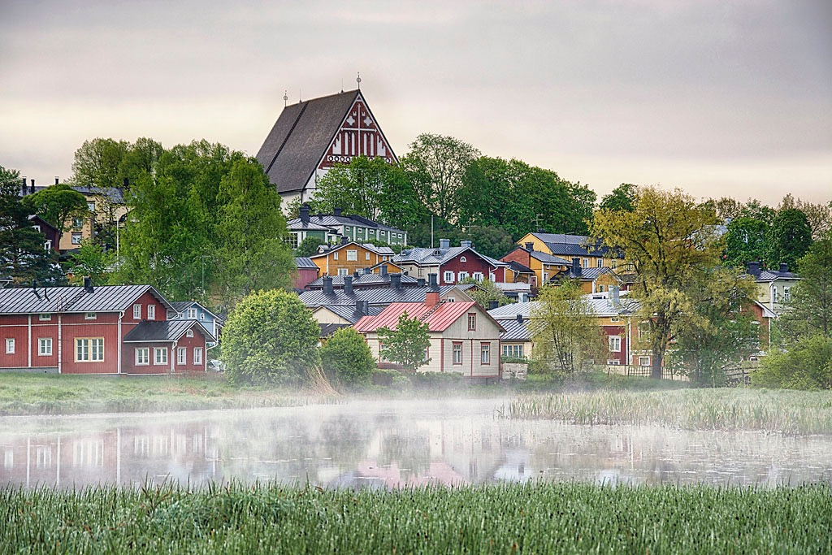
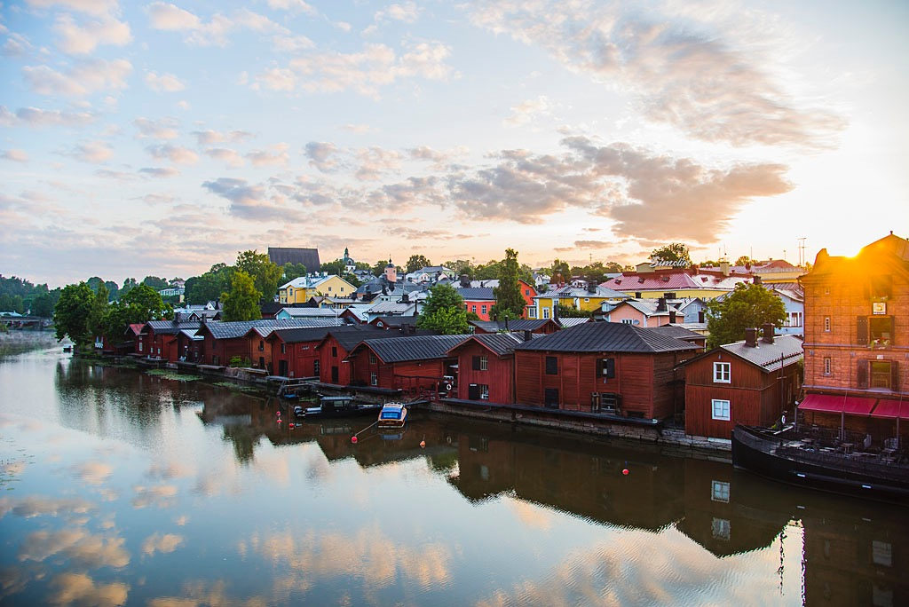
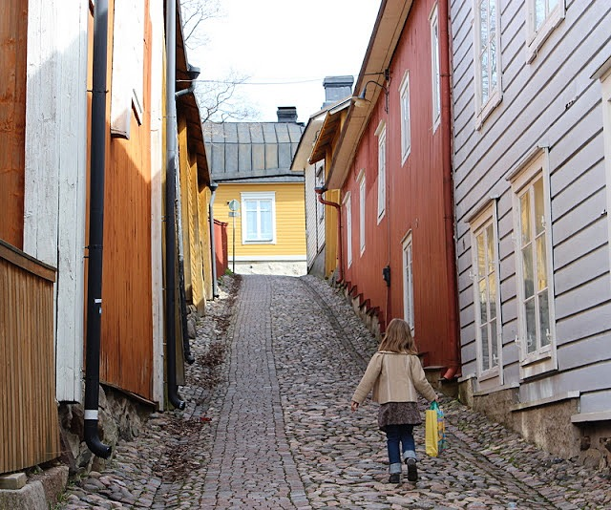
Old Town of Porvoo
The Old Town of Porvoo is unique. The mosaic-like town plan with its maze of streets and irregulary shaped plots dates back to the Middle Ages. Since then the town suffered many fires, but always the stubborn citizens rebuilt their houses on the same foundations.
Photo credits: Visit Porvoo

Slide 5
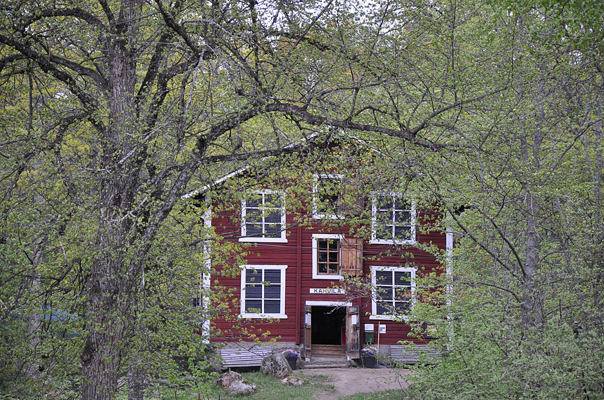
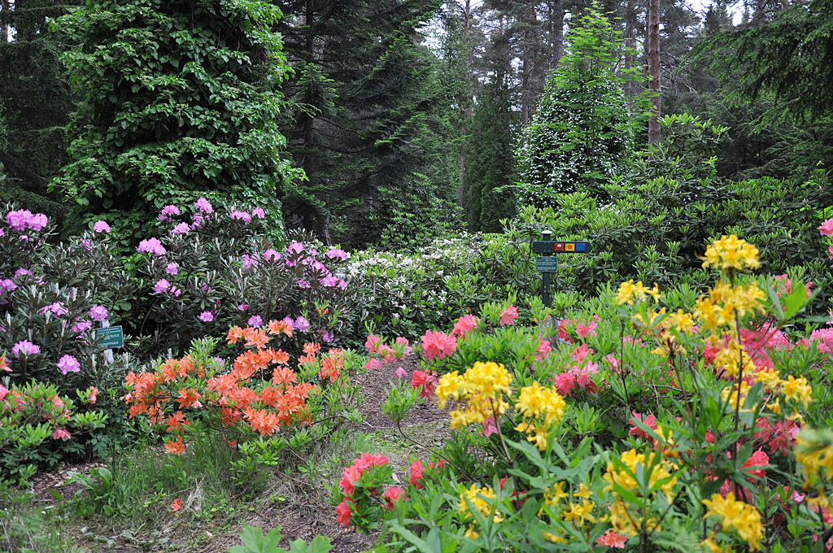
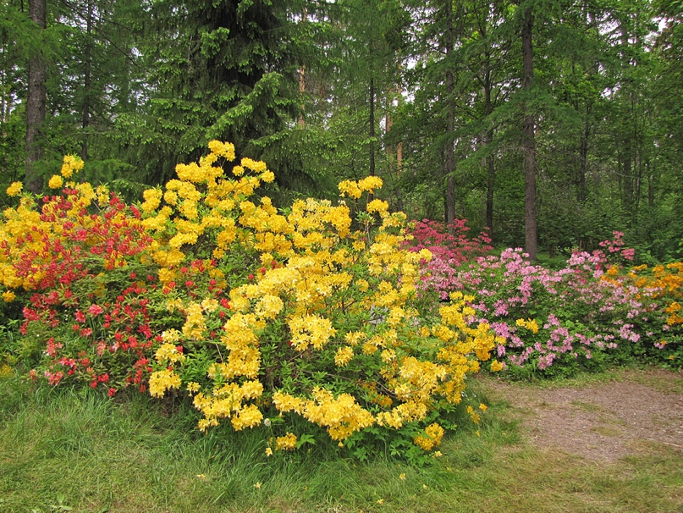
Arboretum Mustila, Elimäki
Arboretum Mustila was founded in 1902 as a test site for exotic conifer species. The Arboretum is especially famous for its rhododendrons and azaleas. In early June a colourful sea of flowers can be seen in the Rhododendron Valley when hundreds of different species and hybrids are blooming.
Photo credits: Jukka Reinikainen and Kristian Theqvist

Slide 6
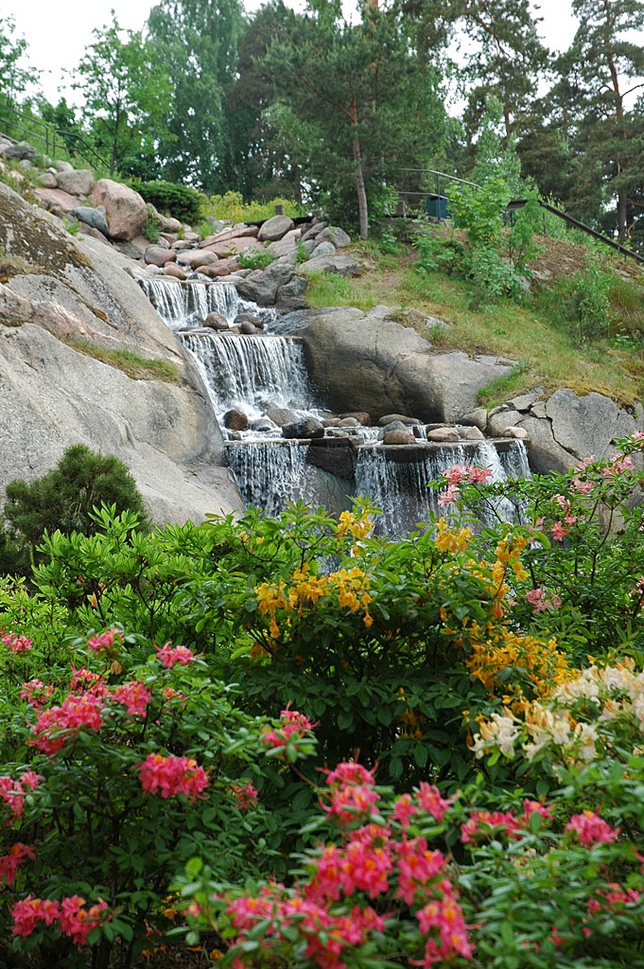
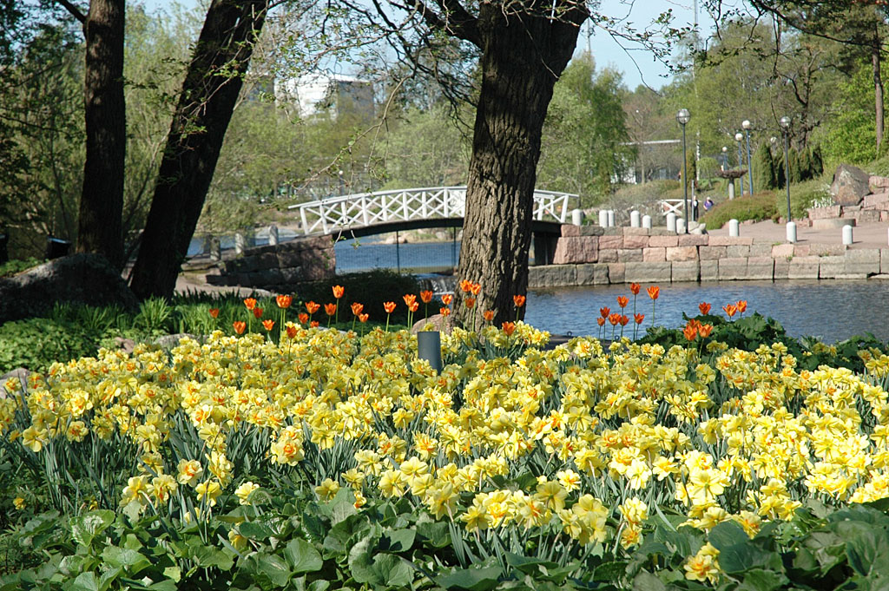
Sapokka Water Garden, Kotka
The Sapokka Water Garden offers many things to admire through every season of the year. In the spring, there are tens of thousands of bulb flowers, and in the early summer the rhododendrons and azaleas come into bloom.
Photo credits: Anne Vilkki-Lanu

Slide 7
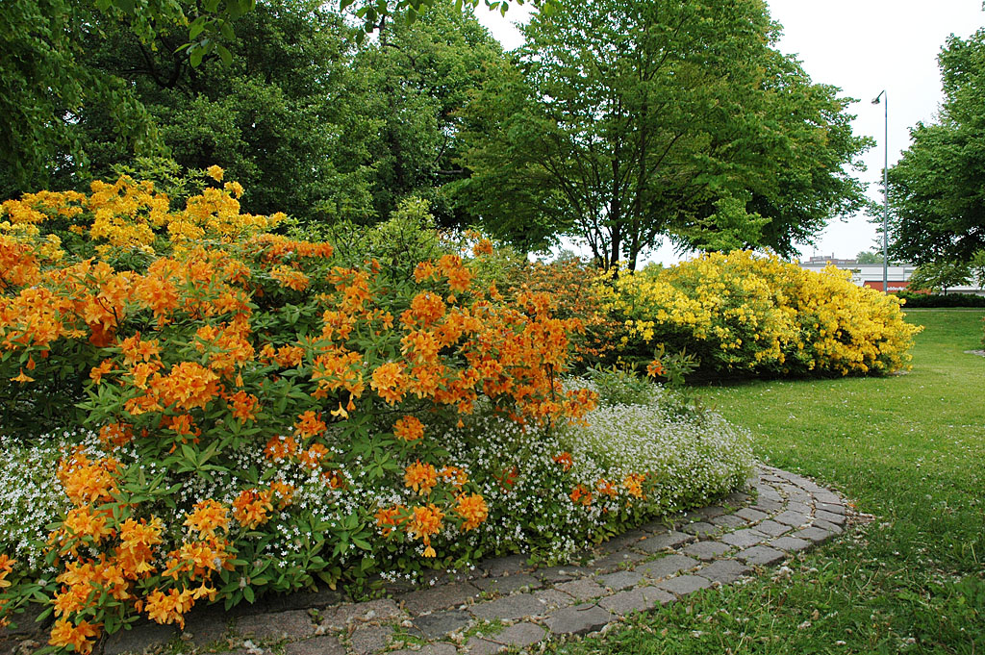
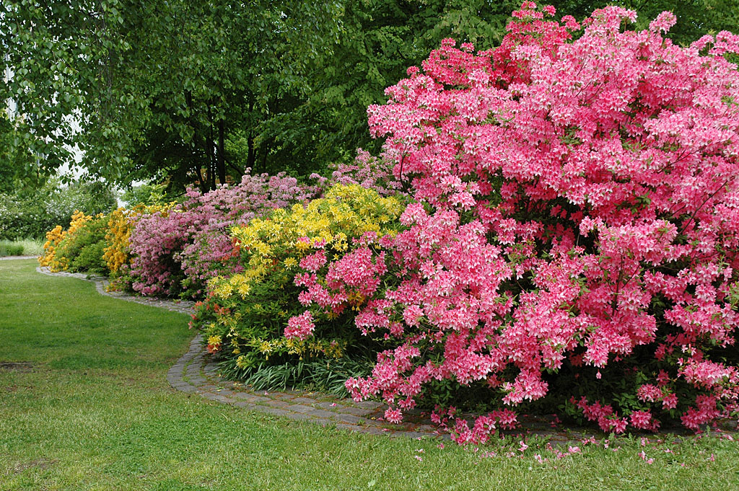
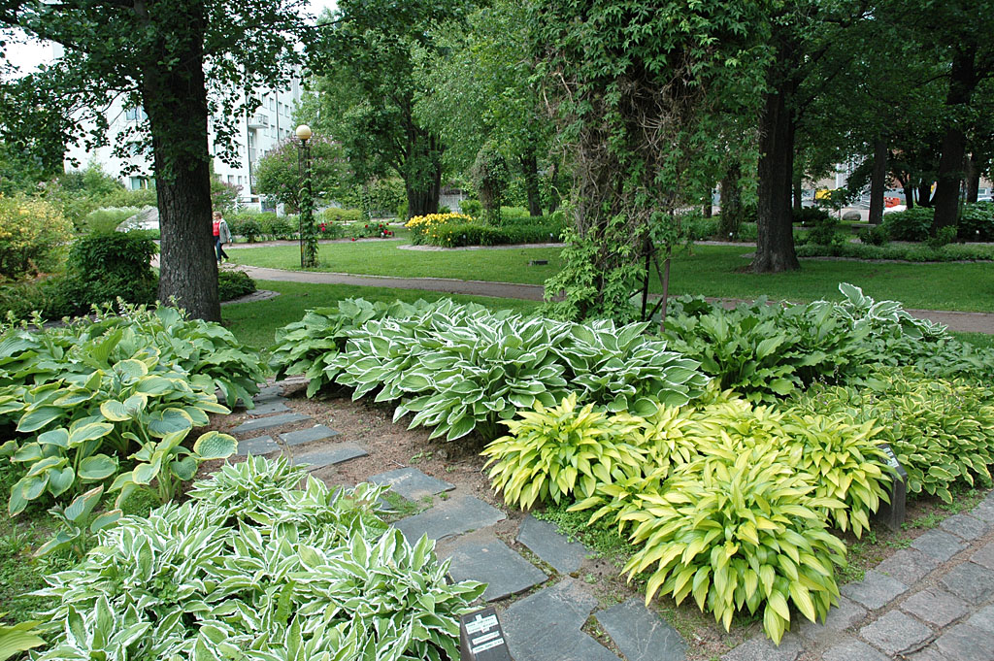
Fuksinpuisto Park, Kotka
Fuksinpuisto Park was established in 1995 as a test planting area for azaleas from the Finnish azalea hybridizing program. Later the plantings were diversified with other plants.
Photo credits: Anne Vilkki-Lanu

Slide 8
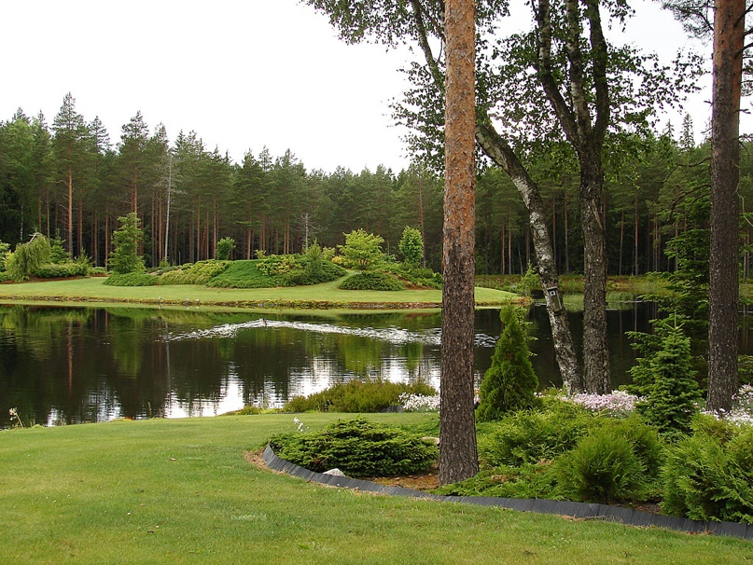
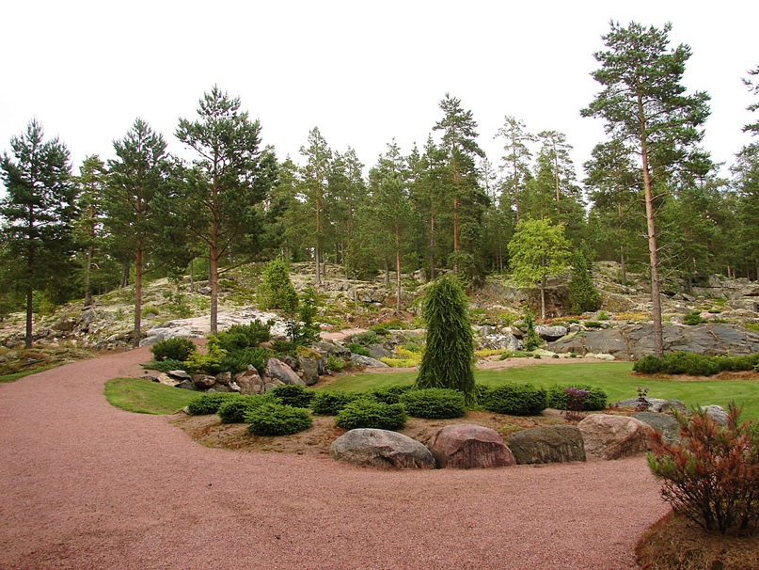
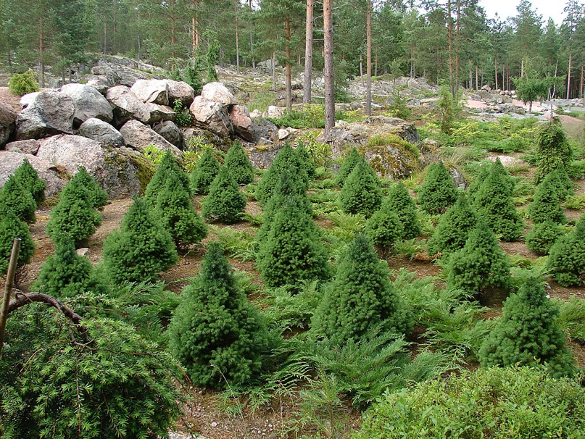
Ilola Arboretum, Salo
The private Ilola Arboretum in the countryside of Salo demonstrates the ultimate in landscaping design, enhancing the diversified natural Finnish landscape in an extraordinary arboretum.
Photo credits: Kajo Haapalainen

Slide 9
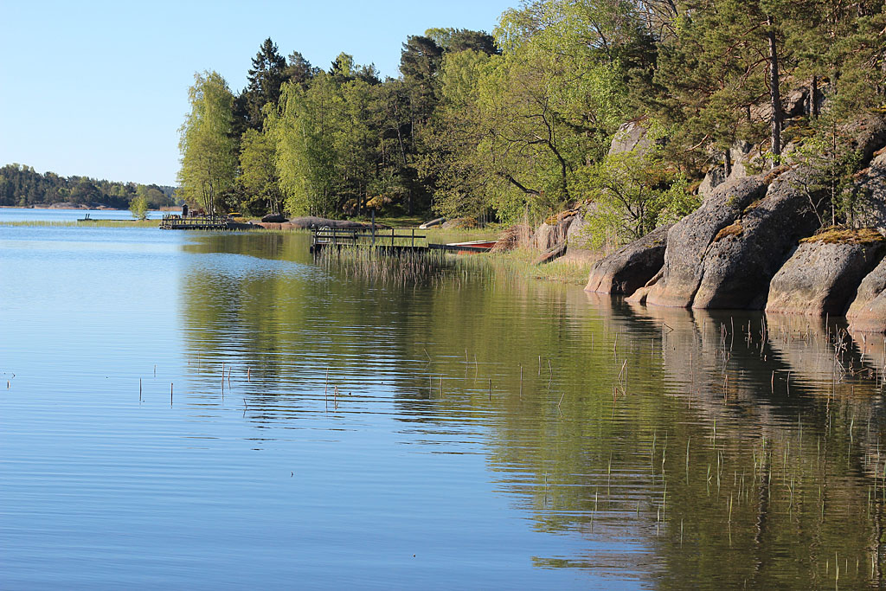
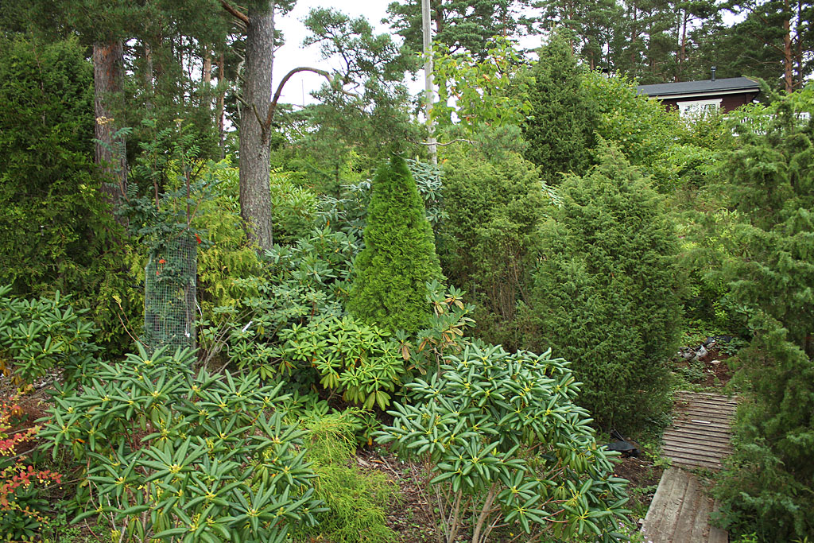
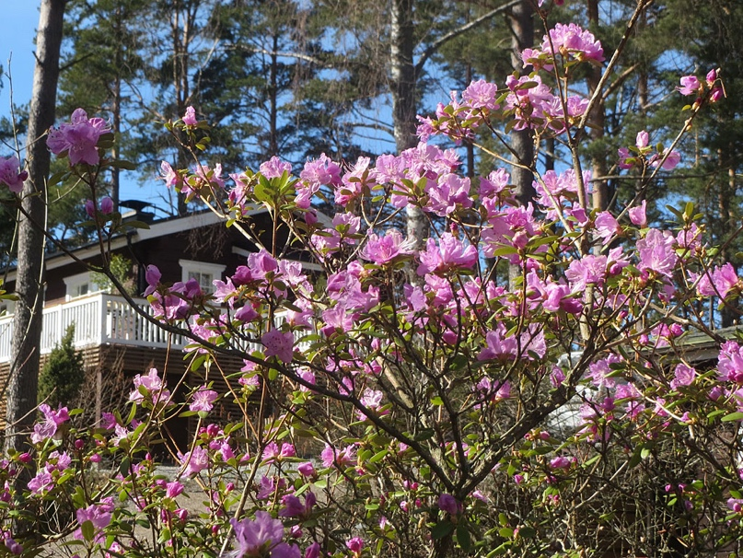
Arboretum Apaskeri, Kustavi
Osmo Jussila has planted hundreds of rhododendrons and other trees and shrubs in the forest and along the shores of Arboretum Apaskeri. Its ten hectares (25 acres) include rhododendron species and cultivars, but also many of Osmo’s own hybrids.
Photo credits: Osmo Jussila

Slide 10
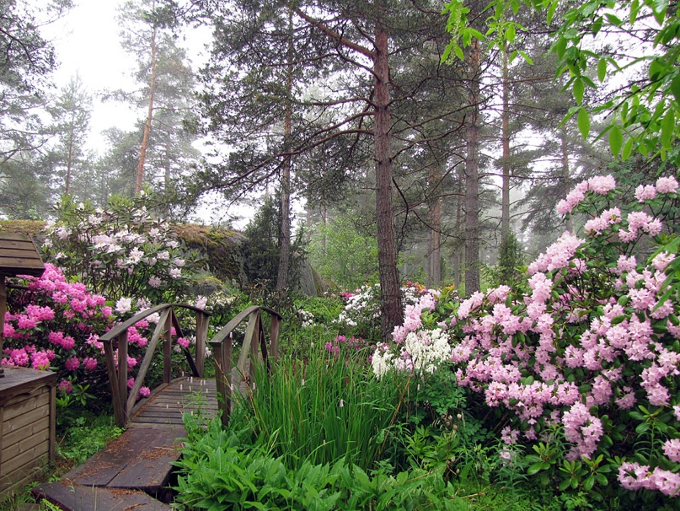
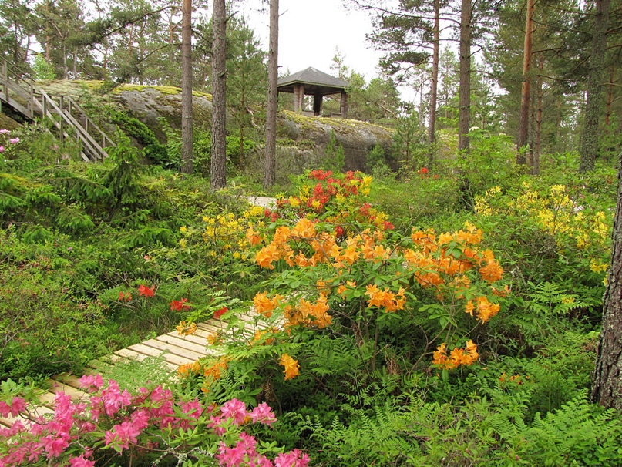
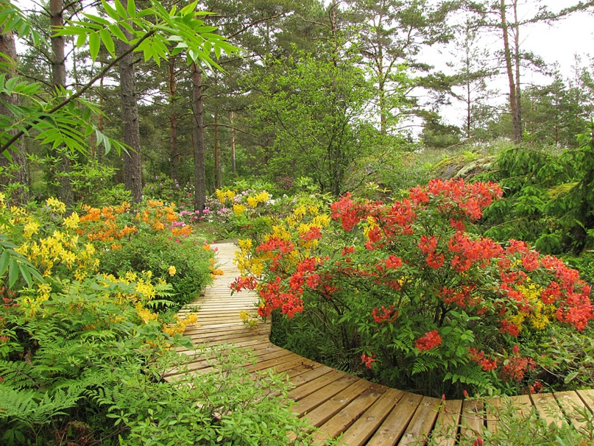
Rhodogarden, Parainen
Rhodogarden is on an island in the Turku Archipelago, in valleys surrounded by high rocks, close to a hidden bay. Kristian Theqvist has planted over 1000 rhododendrons and azales in Rhodogarden below a canopy of pines.
Photo credits: Kristian Theqvist

